Slide 1

Reset Strategies
Making the Most of Stress through Concrete Strategies Fostering Resilience
Kristen Lee, Ed.D., LICSW
@TheRealDrKris
Notes:
‹#›

Slide 2


Slide 3
1 in 5 report that they “never engage in an activity to help relieve or manage their stress.”
Imposter syndrome is particular risk to women in STEM.
Mental health issues projected to grow to more than one third of the global burden by 2030.
Data sources: Global Lancet Mental Health Report (2007), APA (2010, 2014), and WHO (2009).

Slide 4
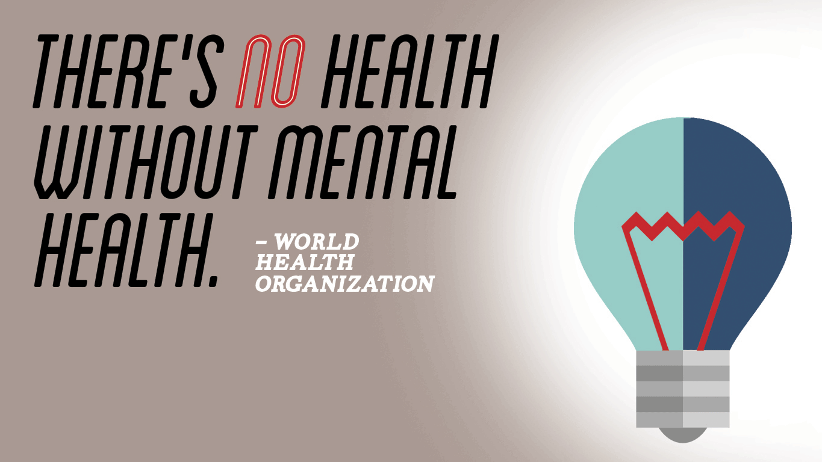

Slide 5
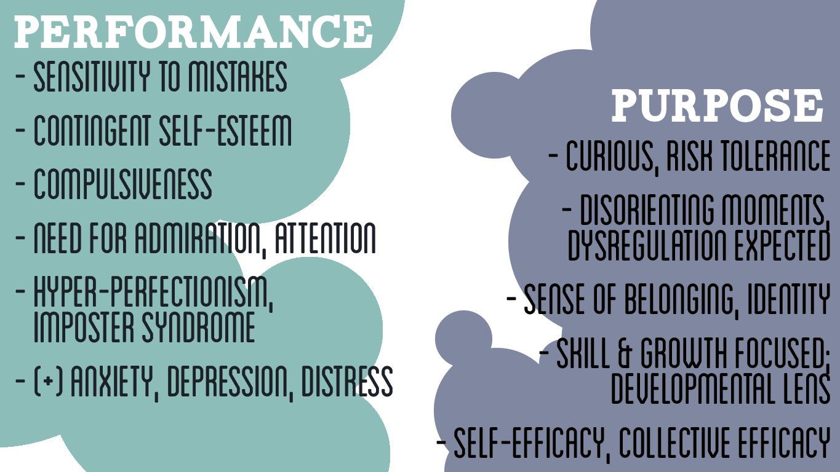

Slide 6
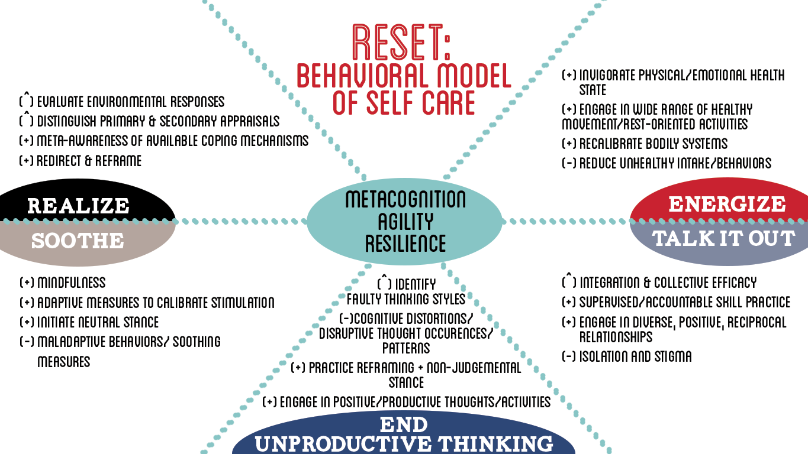
Notes:
‹#›

Slide 7
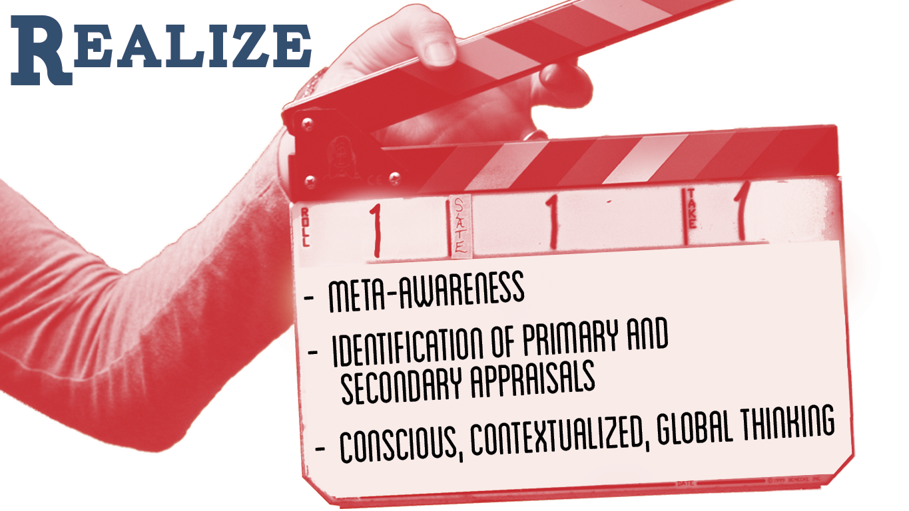

Slide 8


Slide 9


Slide 10
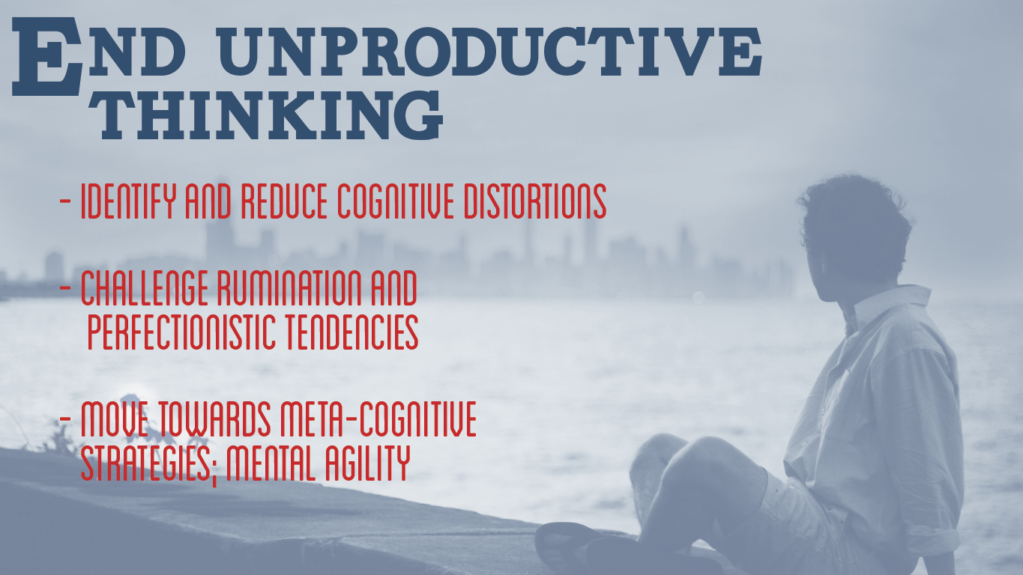

Slide 11
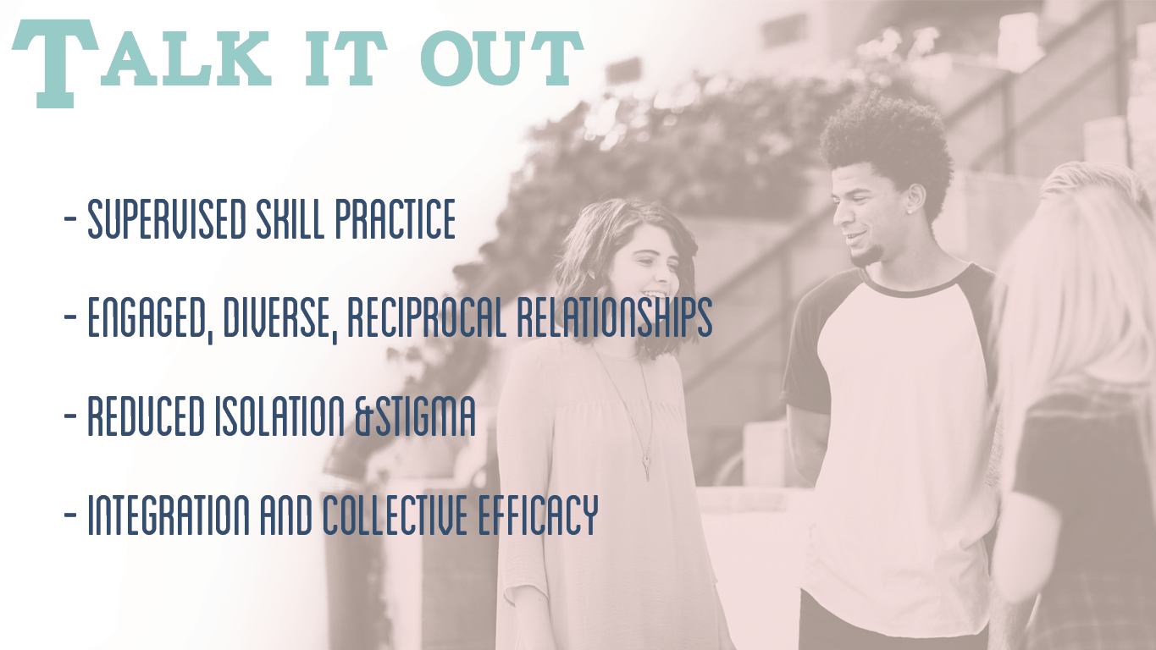

Slide 12


Slide 13


Slide 14
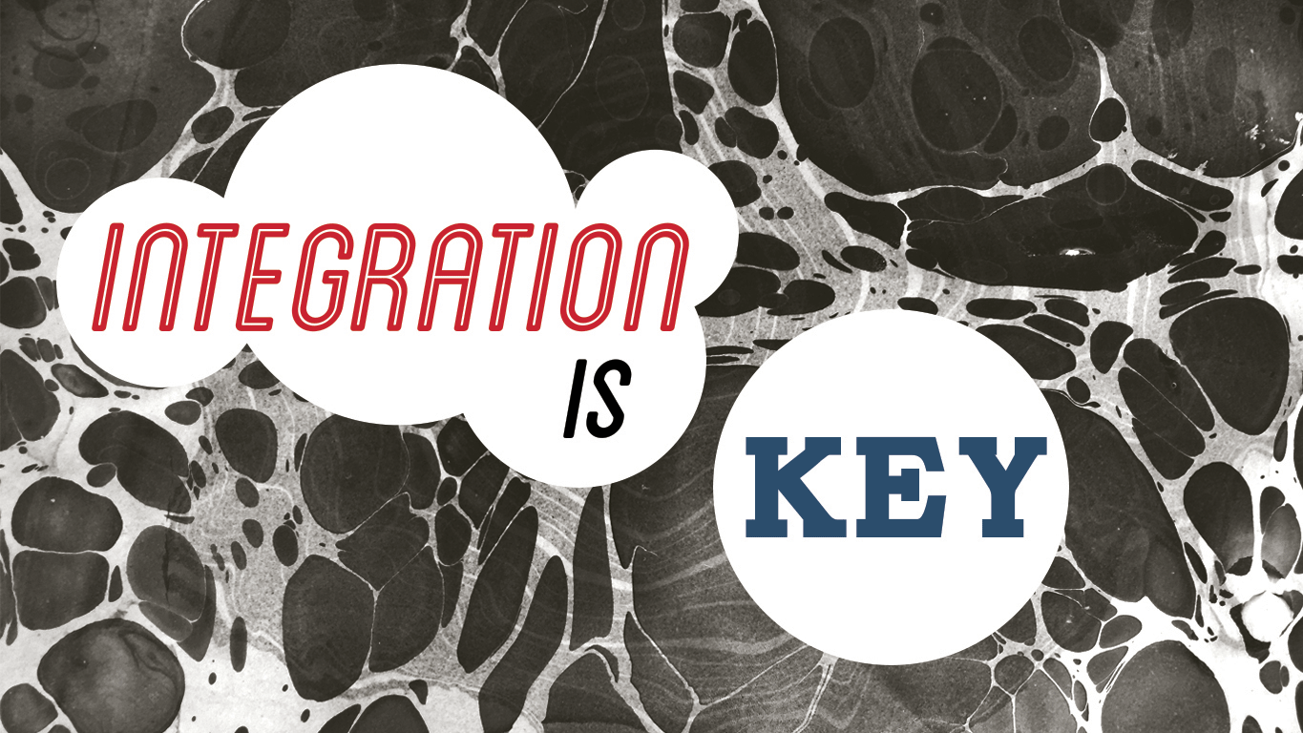

Slide 15


Slide 16


